Slide 1
Day 1 Readiness Checklist
illustration
Weeks
 | Owner | Due date | Status | -9 | -8 | -7 | -6 | -5 | -4 | -3 | -2 | -1 | 0
Prepare internal communications | AD | March 12 | Done
Prepare external communications | Aurelien F. | Jan 20 | Done
Define pricing policy | Christian G. | Feb 28 | Done
Integrate General ledger | George P. | March 31 | Done
Prepare welcome drink for new employees | George P. | March 31 | On Track
Adjust sales pitch | Christian G. | March 31 | Late
Align marketing messages | George P. | March 31 | On Track
Define the synergy targets | George P. | March 31 | Late
Integrate brands |  |  | On Track
Integrate products & services |  |  | On Track
Integrate reporting |  |  | On Track
Define employee retention strategy |  |  | Late
Rationalize employee compensations |  |  | Late
Insert name of activity |  |  | Late

Slide 2
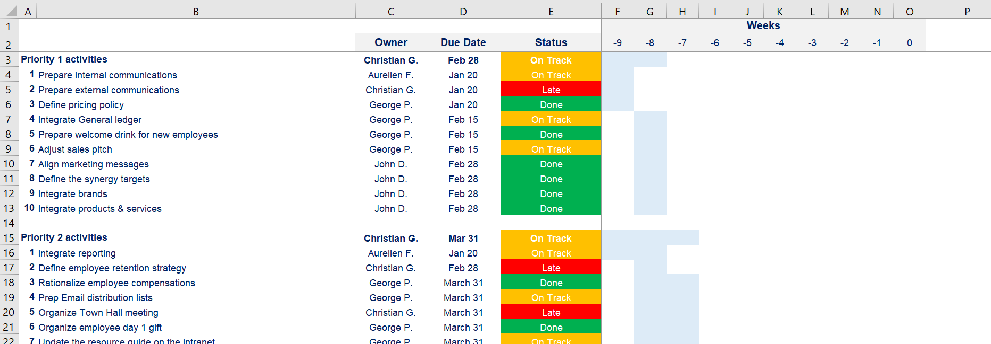
The Day-1 Readiness Checklist often includes many activities that will better fit in an Excel document
Open the Excel document “1b. Day-1 Readiness Checklist” for more details

